Slide 1
Time Series Clustering with R
Yin-Ting (Ting) Chou

Slide 2
Clustering Analysis (Data Segmentation)
What it is ?
It is an unsupervised machine learning technique (unlabeled data).
Grouping data into different clusters.
Minimizing dissimilarity within clusters or Maximizing dissimilarity between clusters.
Applications
Market/ Customers/ Product Segmentation.
Recommendation Systems.
Ex: “The similar products you may also like”
“RECOMMENDED FOR YOU”
Grouping Search Result.
Ex: Yippy (formerly Clusty)
Topical Clustering of Search Results

Slide 3
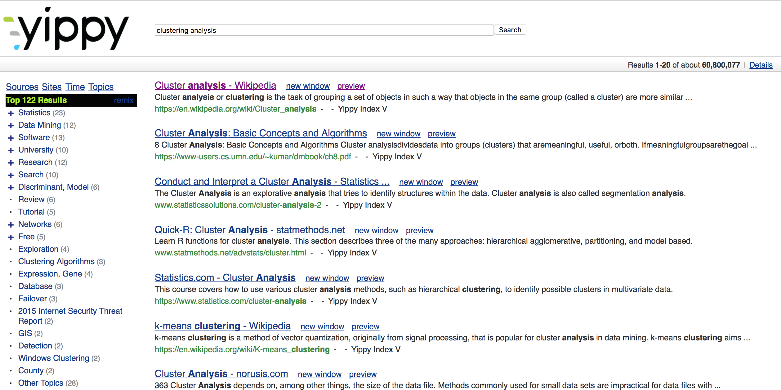
Yippy

Slide 4
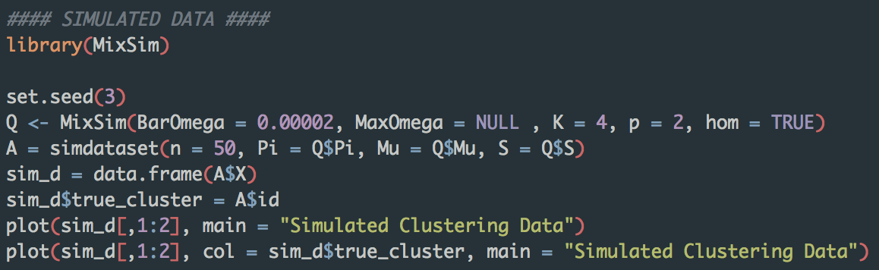
Example Data

Slide 5
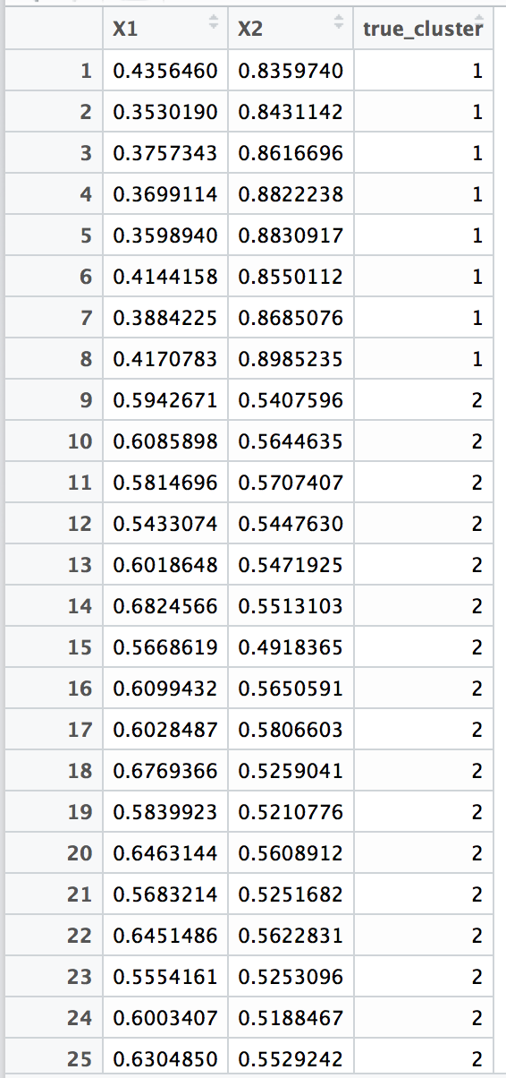
Example Data

Slide 6
Well-Known Methods
K-means Clustering
Specify the number of clusters (K).
Define what is similar or dissimilar
Distance!
Algorithm
Random assign all the points to a unique cluster (k), where k = 1,2,3,…K.
Calculate the mean center point for each cluster (m₁, m₂, …, m_{K}).
Reassign the point to the cluster that it has closest distance to those mean center points.
Repeat 2. ~ 3., until the assignment stop changing.

Slide 7
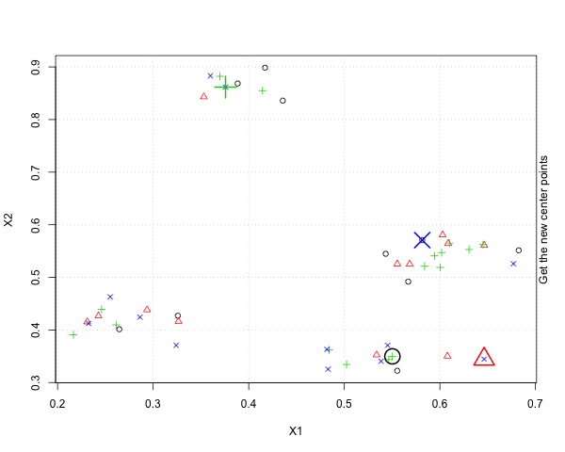
K-means Animation!

Slide 8
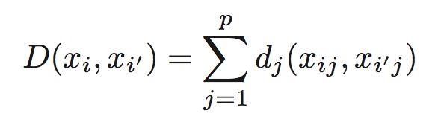
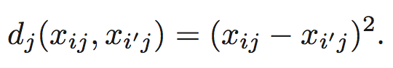
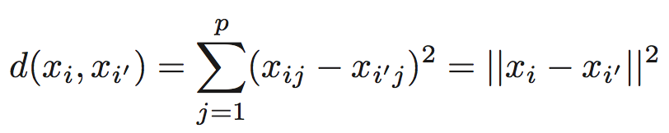
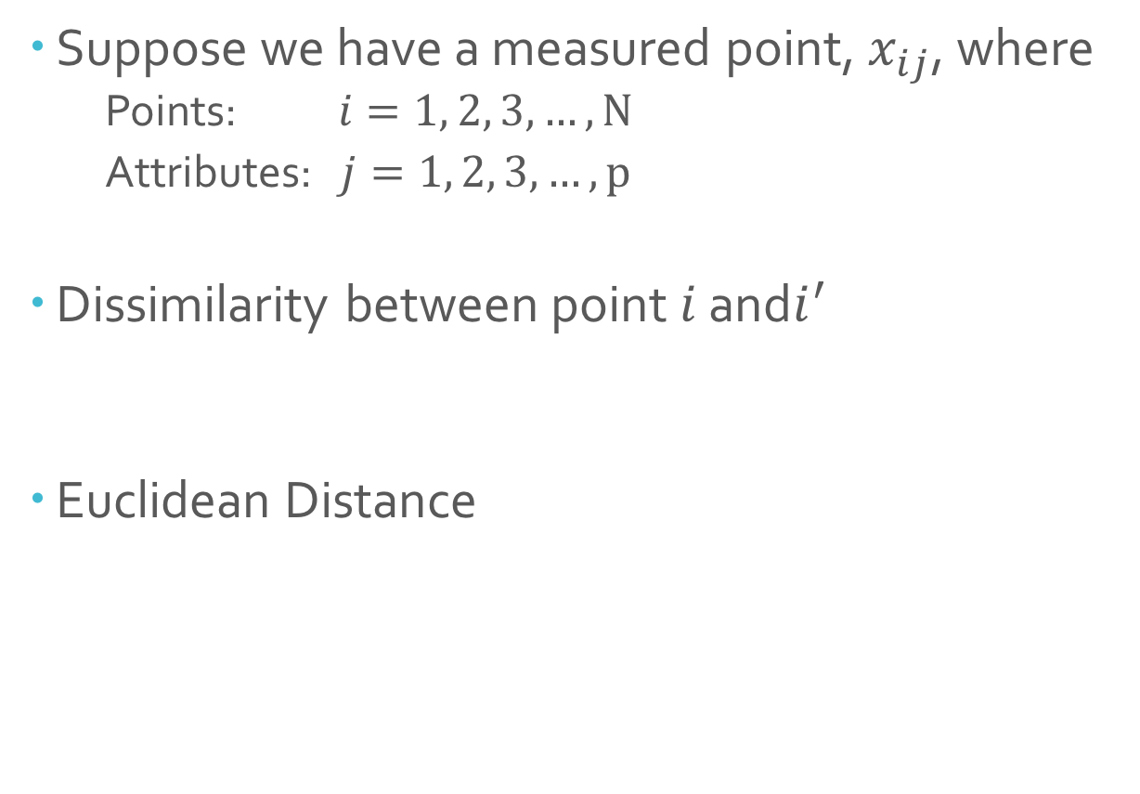
Definition for (Dis)similarity
Suppose we have a measured point, $x_{ij}$, where
Points: $i=1, 2, 3, …, N$
Attributes: $j=1, 2, 3, …, p$
Dissimilarity between point $i$ and$i^{′}$
Euclidean Distance

Slide 9
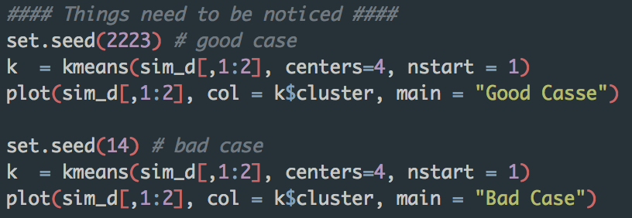
K-means Clustering
Things Need To Be Noticed
You won’t always get the same results. So, do it more times!

Slide 10
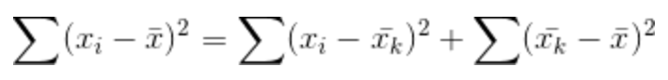
K-means Clustering
Things Need To Be Noticed
How to choose the correct number of clusters ?
TOTAL Sum of Squares = WITHIN Groups SS + BETWEEN Groups SS
(TOTAL variance = WITHIN variance + BETWEEN variance)

Slide 11
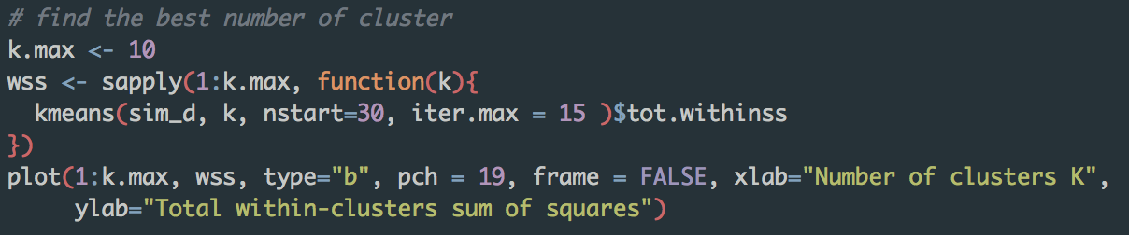
K-means Clustering
An Intuitive Method for finding the best k

Slide 12
K-means Clustering
Things Need To Be Noticed
Standardize the data or not?
The source of pics : here

Slide 13
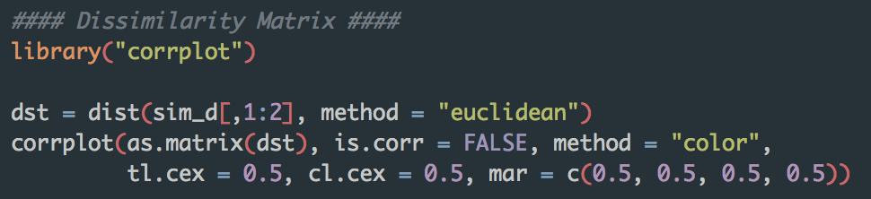
Hierarchical Clustering
Dissimilarity Matrix

Slide 14
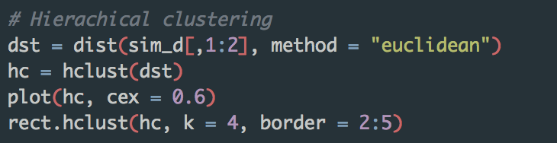
Hierarchical Clustering
Algorithm

Slide 15
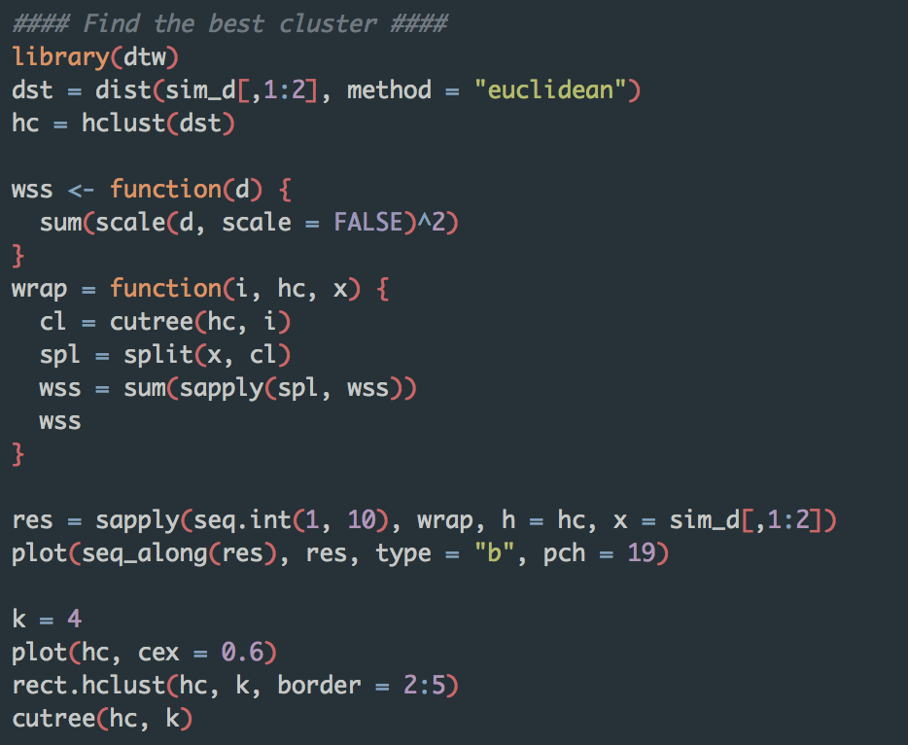
Hierarchical Clustering
Find the Best k

Slide 16
Hierarchical Clustering
Find the Best k

Slide 17
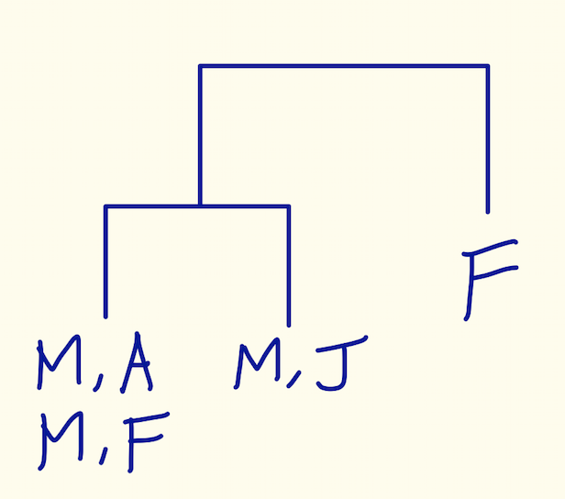
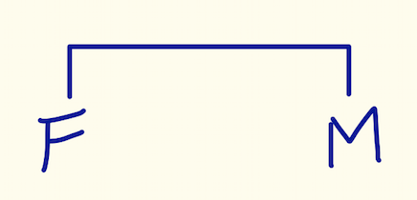
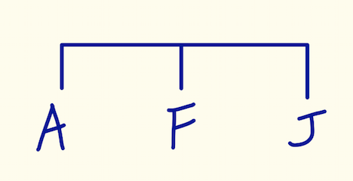
Hierarchical Clustering
Things Need To Know
No need to specify the number of clusters. One Dendrogram can show many clusters.
It assumes that all the clusters are nested with a hierarchical structure, but it may not be the case.
Ex:
x1 = { Male, Female }, x2 = { Americans, Japanese, French }
Best 2 clusters : by Gender
Best 3 clusters : by Nationality

Slide 18
Further Topics
The source of the graph : here

Slide 19
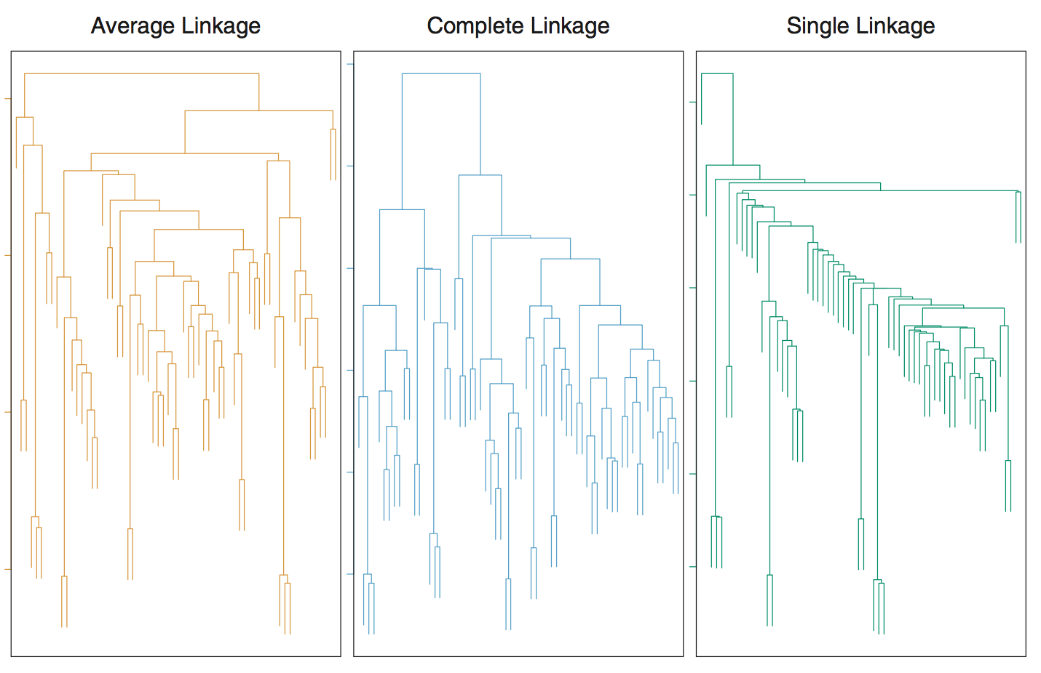
Further Topics
The source of the graph : here

Slide 20
Time Series Data
General Definition
The data is taken by time and believe that time will be an influential factor to the data.
Ex : Sales data ,
Difference in temperature under different treatments

Slide 21
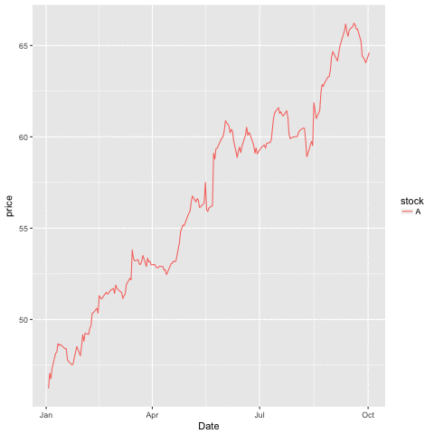
Example Data

Slide 22

Example Data

Slide 23
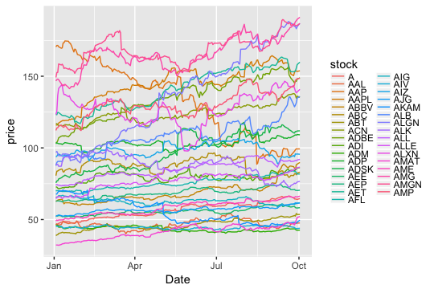
Example Data

Slide 24
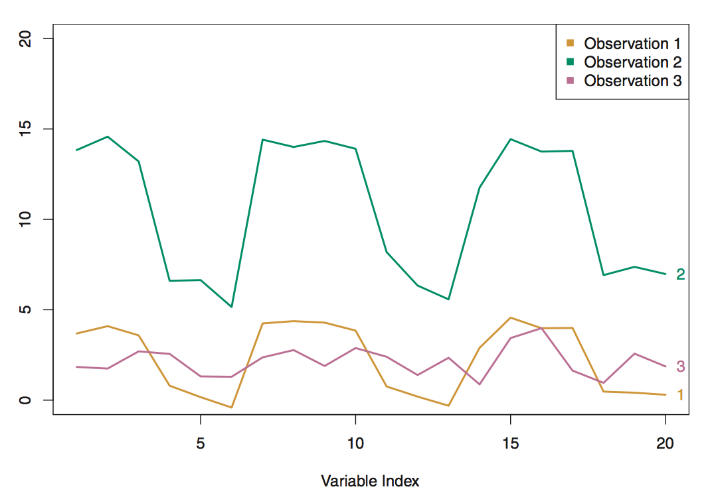
Distance between Time Series
Euclidean Distance may not be what we want.
(The source of this pic : here)

Slide 25
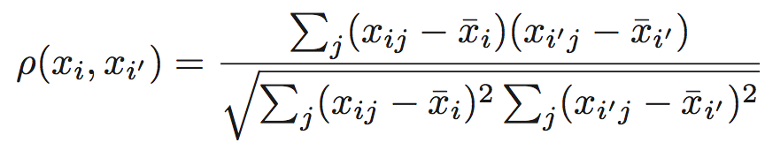
Distance between Time Series
Think about Correlation

Slide 26
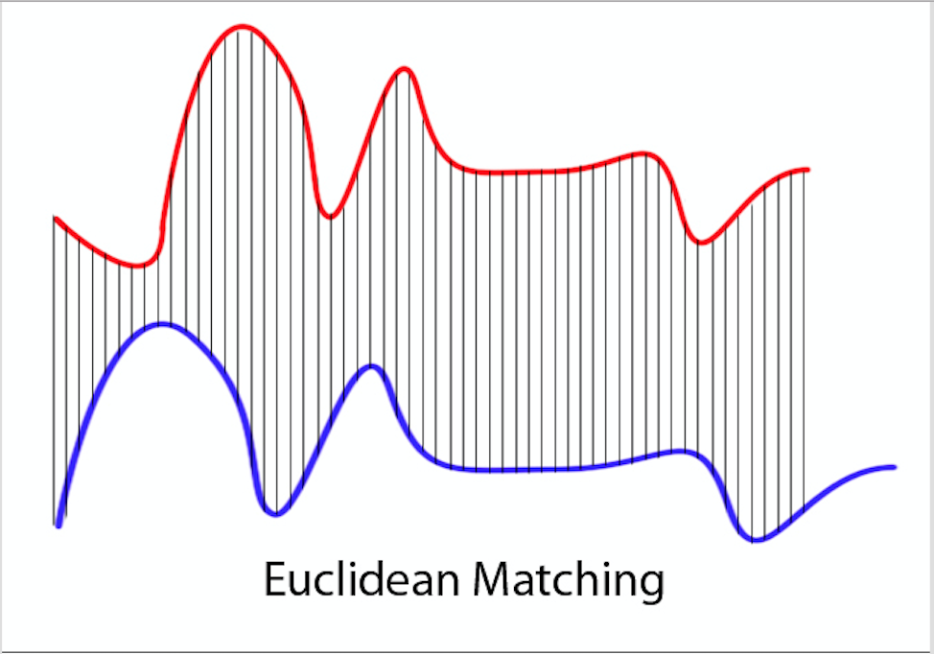
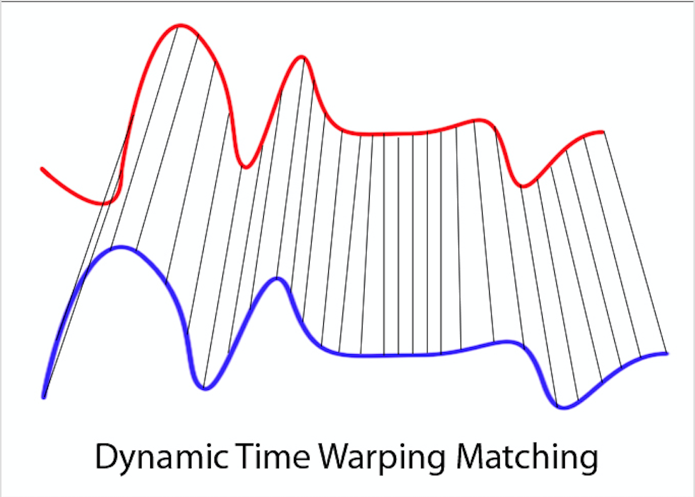
Distance between Time Series
Think about Dynamic Time Warping (DTW) Distance
(The source of this pic : here)

Slide 27
Results

Slide 28
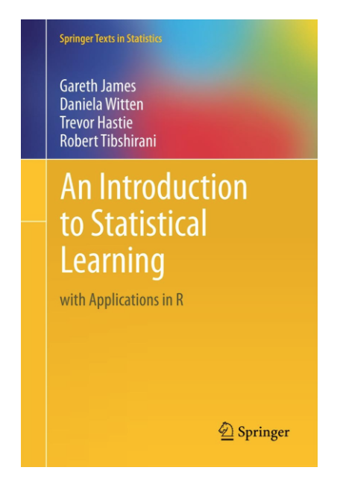
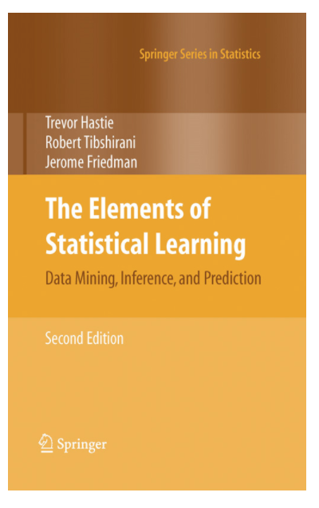
References and Resources
Books
An Introduction to Statistical Learning with Applications in R
The Elements of Statistical Learning: Data Mining, Inference and Prediction
R Packages
MixSim – Generate clustering data
corrplot – Plot the dissimilarity matrix
tidyverse – Data Manipulation
ggplot2 – Data Visualization
amap – K-means with Correlation Distance

Slide 29
Q and A
My personal website and Github
http://yintingchou.com/
https://github.com/choux130/EU_TSClustering_101117

Slide 30
Demo
Rstudio!

